Slide 1
Idea Execution Document for
Making the Elevator Pitch
Entrepreneur’s Unique Registration Code: 69290A4E
Entrepreneur Name: Srikanth Sombhatla
Email id: srikanthsombhatla@gmail.com
Mobile number: 919885851504

Slide 2
Define the company/business in a single declarative sentence
My idea aims to simplify local train ticketing by providing a service to buy daily, monthly, platform tickets through a toll-free SMS.

Slide 3
Company Profile
Don't have a company yet !
Team – Apart from myself I don’t have a team.
About myself...
Srikanth Sombhatla , Information Technology Graduate
Senior Software Engineer, KPT India, Hyderabad
4.5 years of mobile domain experience.
Zest for productive innovation.
Contact details : 919885851504

Slide 4
Need
Describe the needs your business idea is trying to fulfill.
Need is to simplify local train print ticketing, platform ticketing and reduce long queues before ticketing counters.
How are these needs met currently?
Human resources at ticket counters and automated kiosks serve the purpose currently.
Who are your target customers?
Possible target customers are local train travelers and visitors having a mobile phone.
Businesses who want to source ads through ticket confirmation SMS.
09/04/10
Notes:
Describe the needs you are trying to fulfill. How are these needs met currently?
Illustrate the customer inconvenience you are trying to remove, how are you making her life better? How is the customer solving these problems currently?
Who are your target customers? What is the market potential?
Identify various segments who would be using your product service, assess the market potential in terms of value/volume?

Slide 5
Market Potential
Millions of ridership across the country buying local train tickets.
6.94 million daily ridership in Mumbai Suburban trains.
1.5 million daily ridership in Hyderabad MMTS.
Millions of upcoming Metro travelers across multiple cities.
Visitors buying platform tickets.
Businesses pay for ads that cover huge ridership.
Can address abroad markets too like Americas, Europe, China.
Can extend to local road transport also.

Slide 6
Value Proposition
Describe your offering.
Centralized SMS server/gateway allowing ticket booking through a toll-free SMS.
Billing done directly from customer’s phone balance, via respective operator support.
Ticket confirmation SMS take the place of printed ticket.
Each ticket confirmation SMS is sourced with a contextual ad.
More at http://bit.ly/mobileticketing
How does this offering solve the problem?
Commuters can comfortably book tickets via SMS as and when they arrive at terminal.
Each mobile is a personal ticket counter!
No sequence problem, no long queues.
Notes:
Describe your offering
Please provide description of your product or service
How does your offering solve the problem?
Explain your product/service, put in links to photos, demo videos etc if needed.

Slide 7
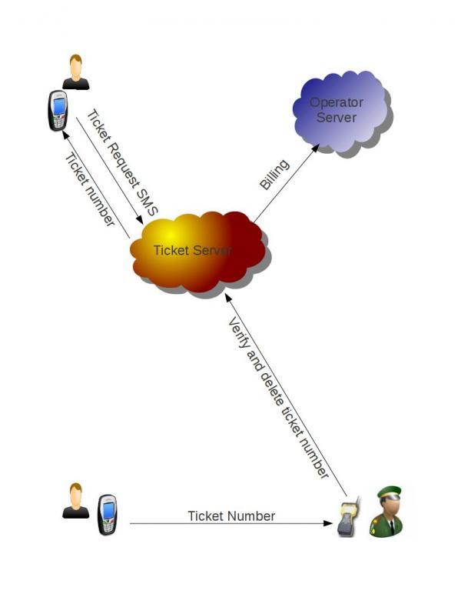
Big picture

Slide 8
Case study
Srikanth's office is 25 km, on the other end of city. So he relies on local trains. On his way to train station he sends a SMS to book a ticket from Secunderabad to Hitec City. When he reached station, he smartly escaped the long rush-hour ticketing queue and comfortably entered the train. With no extra charge for SMS and the standard train fare of Rs. 4 is deducted from his mobile balance. When ticket collector queries for ticket, he simply shows his ticket confirmation SMS.
He also sees a text ad in ticket confirmation SMS, that Style-Center mall (which is nearby his office) is offering 15% flat discount on DVD players. On his way home, he buys a DVD player for his wife!
Moreover, instead of retyping the SMS everyday, he resends the same SMS and enjoys the travel without ever looking at a ticket counter.

Slide 9
Competition
Competitors are traditional ticket queue and ticketing kiosks
They just don't solve the sequential problem and long queues.
How is this solution better than that of the competitor’s?
Commuter can book ticket with the comfort of his/her mobile phone.
Toll free SMS.
This doest requires commuters to stand in queue. So no long queues at ticket counters.
Same cost as print ticket. No extra charge!
Its green ! No paper and print cartridge wastage.
Notes:
List Competitors and their offerings
If you think you have no competition, you may not have researched well enough, or there might not be a market for your offering. So please think twice before saying there is no competition
Also try to identify potential competition- who else could enter the market and be a significant threat.

Slide 10
Business Model
How do you plan to make money?
Share revenue from money saved on print cost of each ticket.
Maintenance of ticket server.
Text ads with every ticket response SMS.
Ecosystem of mobile apps and ads sourced to apps.
Ads are contextual and charged per ticket.
How will you price your product/service?
Same as traditional paper ticket. No extra charge. This price model makes it an equal alternative.
How will you reach out to your consumers/deliver your product to them?
Rigorous publicity in social media. Deep publicity push in railway premises.
Publicity at ticket counters.

Slide 11
Business Model continued...
What are your funding requirements?
Investment for setting up and maintenance of a toll-free SMS gateway and phased rollout in Hyderabad MMTS and Chennai MRTS.
Funding required for creating a channel to source ads.
Next phase of covering Mumbai, all Metro transport systems across country.
With more pan India coverage, ad value increases and generate profits.
Investment to identify and serve abroad markets and local road transport.
Partnership
Public-Private Partnership.
Partnership with local ad sources like JustDial, Google to source ads.

